Slide 1
Flight Fare Prediction

Slide 2
1.INTRODUCTION
Objective:
Development of a predictive model using the data of prices of flight tickets for various airlines between the
months of March and June of 2019 and between various cities.
Benefits:
More efficient travel planning.
Increase the time saving.
Enhanced customer retention.
More affordable travel

Slide 3
2.WORKFLOW TO BE FOLLOWED
Loading The Dataset.
Data Pre-processing.
Feature Engineering.
Performing EDA.
Model Training & Evaluation.
Testing The Model On New Data.

Slide 4
3.DATA PREPROCESSING
Data Cleaning:
Checking for Null values
Check for Spelling correction.
Checking the data types.
Checking for duplicates.
Checking for outliers
Encoding the categorical data.
Scaling or normalizing the data.
Feature Selection.

Slide 5
4.EXPLORATORY DATA ANALYSIS
EDA is of two parts.
Distribution plot or Count plot for features
Feature Vs Target Plot

Slide 6
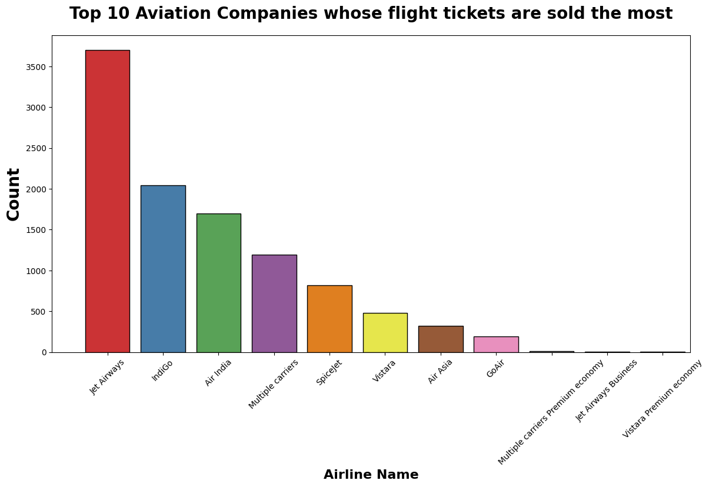

Slide 7
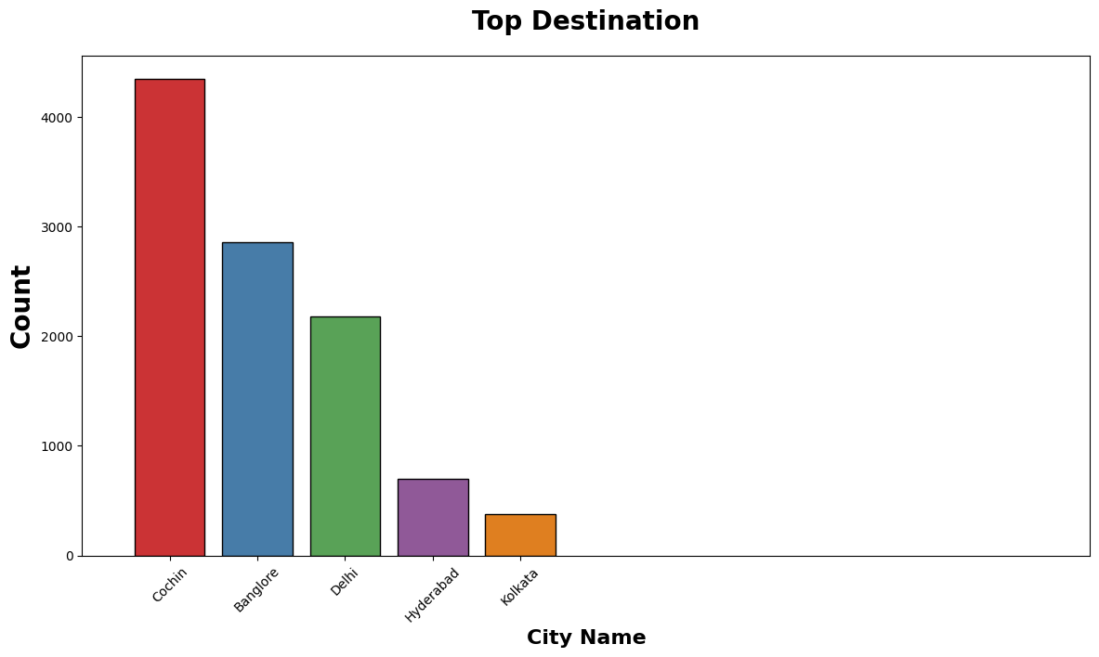

Slide 8
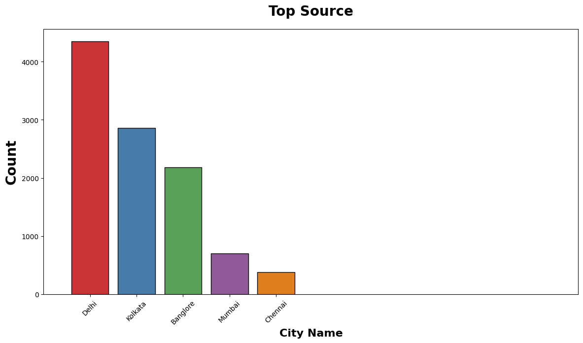

Slide 9
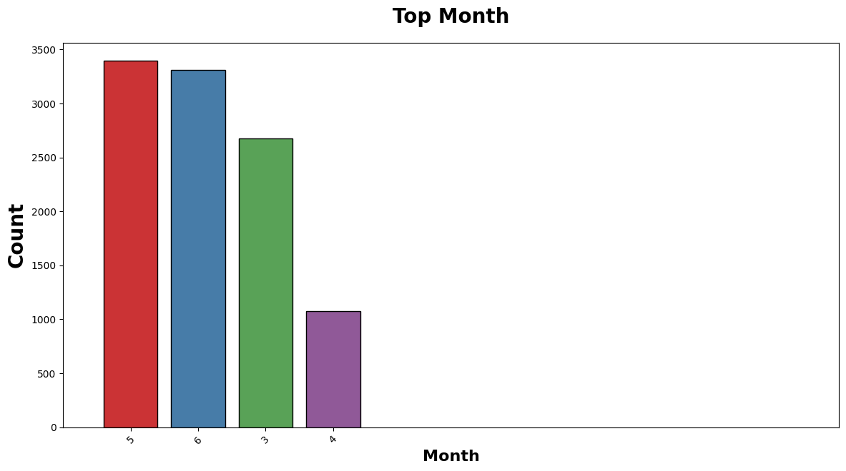

Slide 10
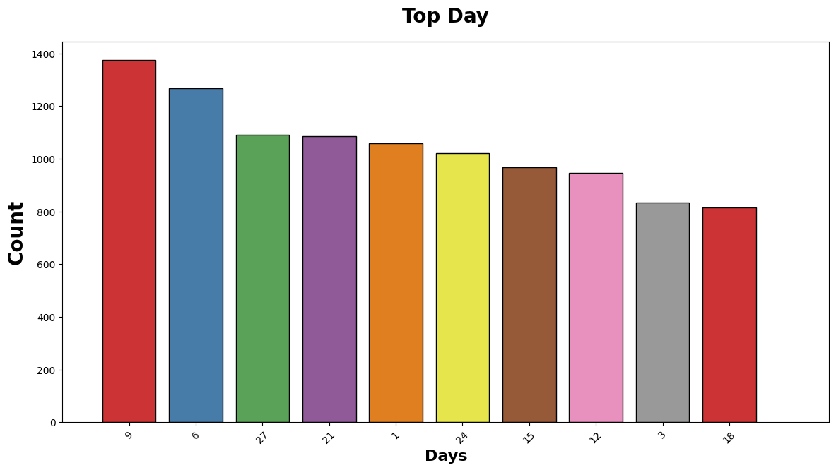

Slide 11
TARGET VS FEATURE PLOT

Slide 12
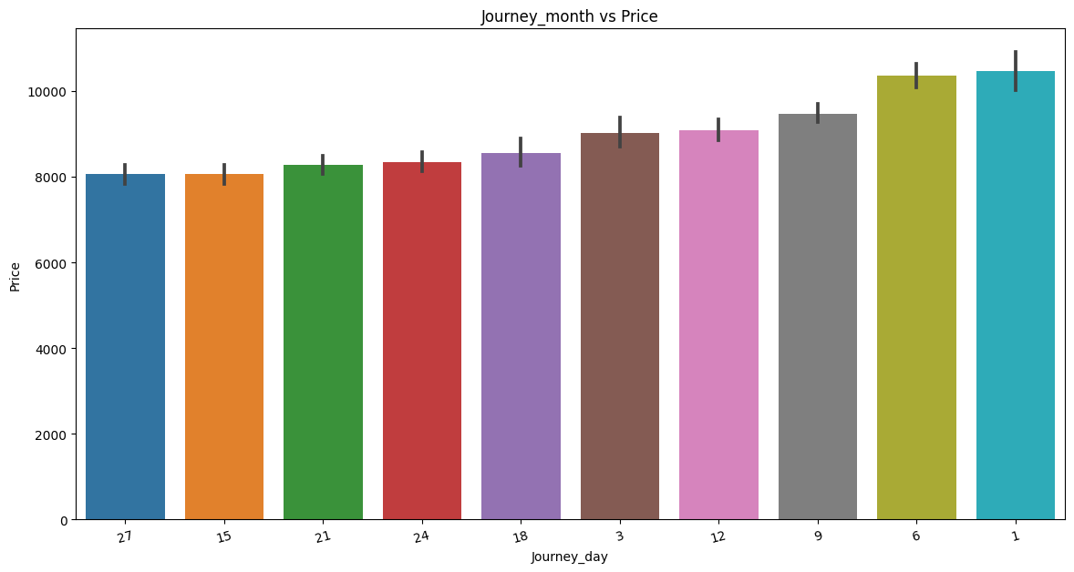

Slide 13
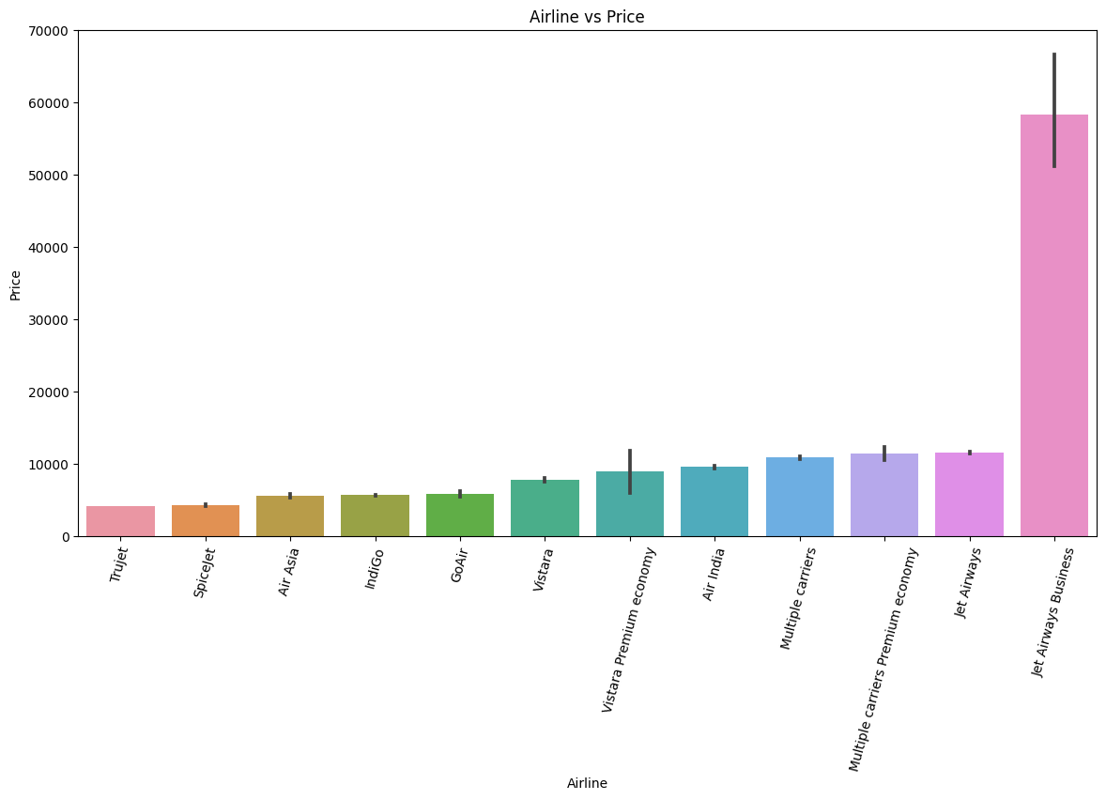

Slide 14
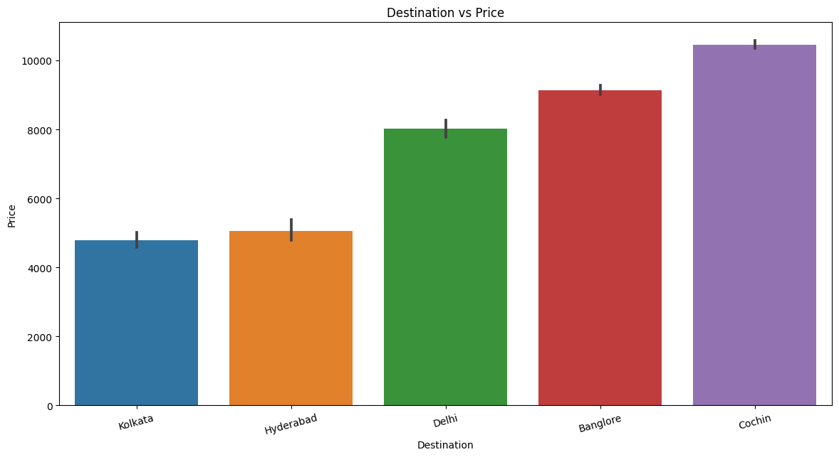

Slide 15
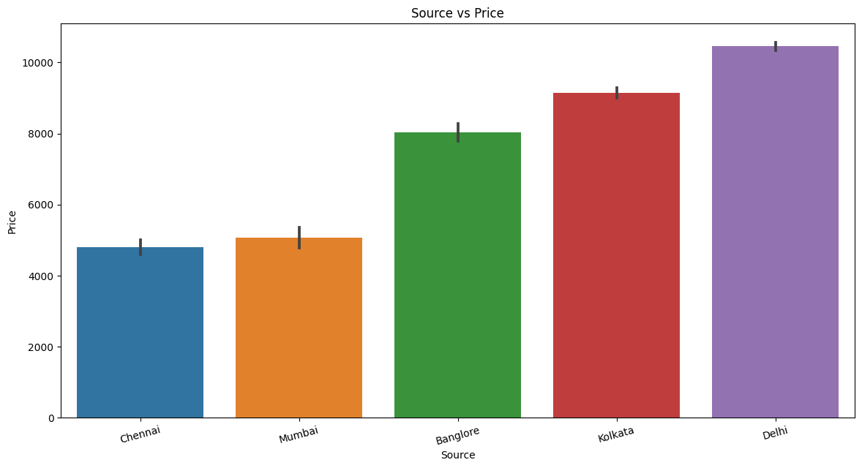

Slide 16
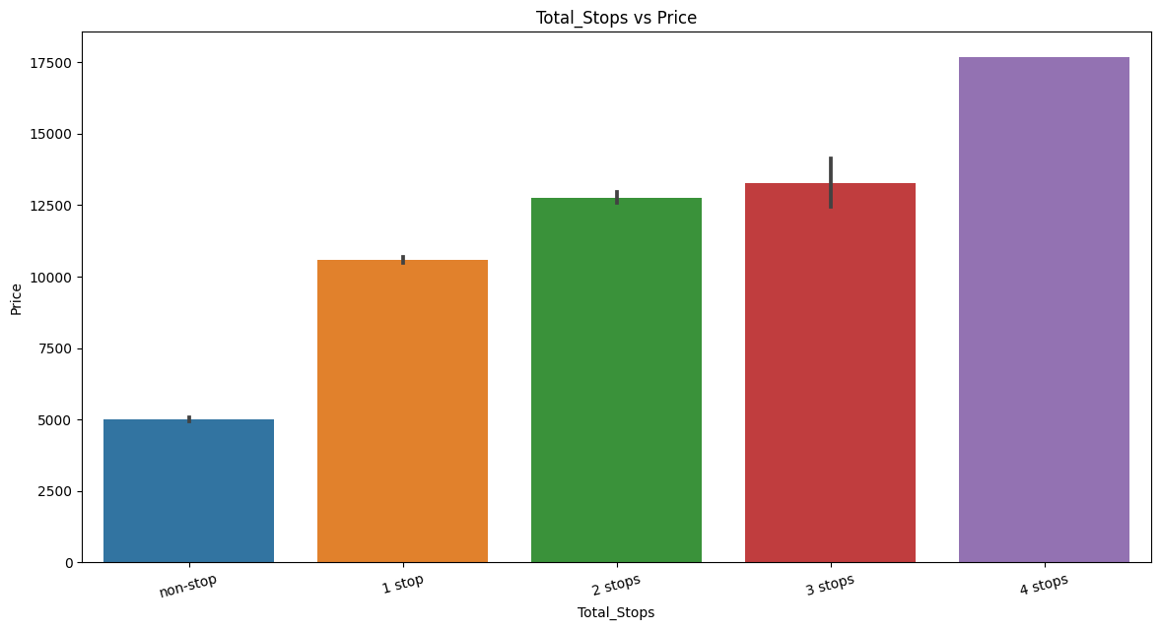

Slide 17
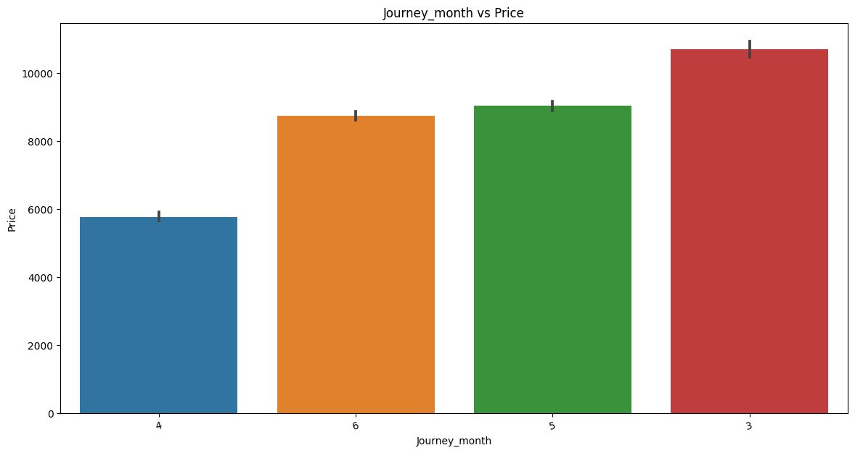

Slide 18
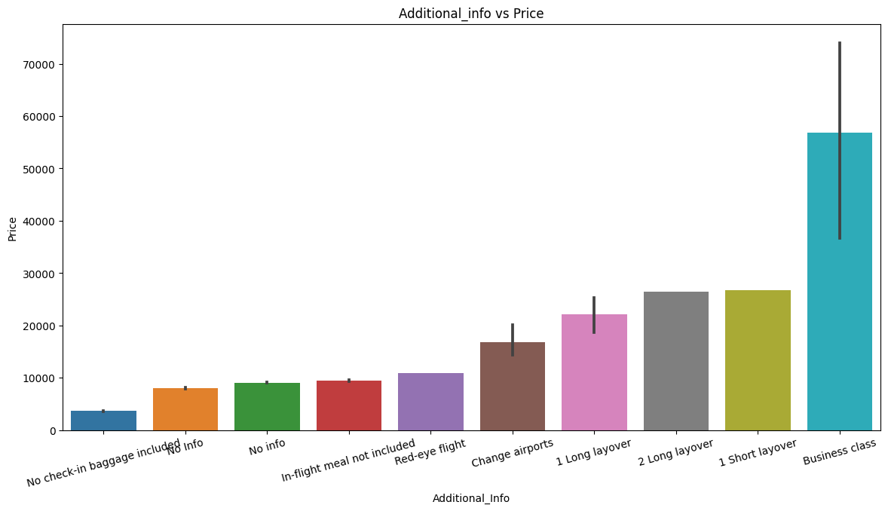

Slide 19
5.MODEL OUPUT
Prediction:
Split The Data Into Training and Validation Sets
Scaling The Data if Required By The Model
Loading & Fitting The Model On The Training Data
Predict Y_test using X_test
Calculate MAE, MSE,R2 Score, & RMSE Score For Evaluating The Model
Index | Model | Mean Squared Error | Mean Absolute Error | RMSE | R2 Score
0 | Linear Regression | 9601156.13 | 2187.01 | 3098.57 | 0.52
1 | K Neighbors | 5031736.63 | 1413.43 | 2243.15 | 0.75
2 | Decision Tree Regression | 4188292.58 | 1352.21 | 2046.53 | 0.79
3 | Random Forest Regression | 3446603.26 | 1179.44 | 1856.5 | 0.83
4 | Extreme-Gradient Boosting Regression | 3644263.45 | 1312.75 | 1908.96 | 0.81

Slide 20
At the end of these analysis, we came to know that customers must choose the right day, non stop flights and flights with less duration, so that they can get the flights at cheapest price.
6.BUSINESS INTERPRETATIONS
IMPORTANT FEATURES FOR MAKING PREDICTIONS:
1.Duration Of the flight: As the Duration of the flight increases the price also increases.
2.Journey_day:We can see the journey day plays an important role, the prices are high on the weekends than the week days.
3.Total_stops:The flights with more stops are high priced when compared to the flights no stops.

Slide 21


